Slide 1
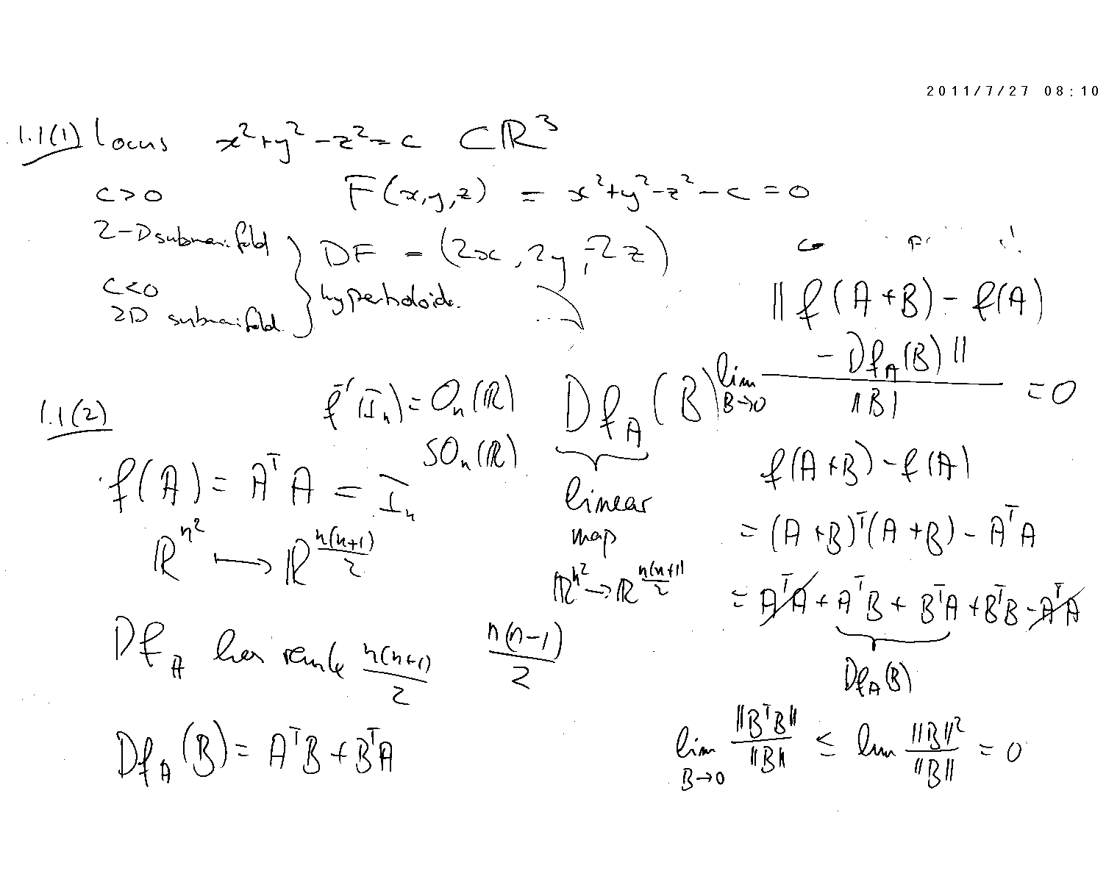

whiteBoard.
  →   
home courses email discussion calendar services
CS – 129 - 1
Inbox : 15 new messages
announcements
assignments
results
help
○
Recent Activity
Assignment 3.4 due 12/1/16 – 4:30pm View submissions
___________________________________________________________________________
Announcements
Posted on Wednesday, November 31, 2016 7:35pm EST
Be sure to include a set of links in the discussion forum when..
___________________________________________________________________________
Discussion
No new discussions
___________________________________________________________________________
−
☞
✴
Create thread
expand
edit
delete
wB

Slide 2

whiteBoard.
  →   
home courses email discussion calendar services
CS – 129 - 1
Inbox : 16 new messages
announcements
assignments
results
help
○
create new
−
Assignments
Assignment 1.1 All Submissions Evaluated
Assignment 1.2  - 5 Submissions
Assignment 2.1  - 19 Submissions
Assignment 2.2  - 16 Submissions
Assignment 2.3  - 19 Submissions
Assignment 2.4  - 18 Submissions
Assignment 3.1  - 19 Submissions
Assignment 3.2  - 15 Submissions
Assignment 3.3  - 15 Submissions
Assignment 3.4  - None Submitted Yet
☞
−
✴
−
−
−
−
−
−
wB

Slide 3
whiteBoard.
  →   
home courses email discussion calendar services
CS – 129 - 1
Inbox : 25 new messages
announcements
assignments
results
help
○
create new
−
Assignments
Assignment 3.4
Student Submission Result
Brandon Wharton  
Danny Davito  
Marry Poppins  
Quentin Tarantino ---- 0%
Roger Wilco  96.5%
☞
✴
wB

Slide 4
whiteBoard.
  →   
home courses email discussion calendar services
CS – 129 - 1
Inbox : 68 new messages
announcements
assignments
results
help
○
New Assignment
−
Title:
☞
✴
Description:
Day
Month
Year
Due Date:
dd
mm
yyyy
Preview
Submit
wB

